Slide 1
RESUME INSIGHTS AND OPTIMIZATION
Capstone Project
Presented to Prof. Chaoji Wang
By,
Sreya Sree Siloju

Slide 2
CONTENTS
What is resume screening?
Why resume screening?
How resume screening?
How resume screening helps?

Slide 3

WHAT??
Analyzing resumes to extract key details like skills, experience, and education.
Improving resumes to highlight relevant skills, qualifications, and achievements for specific job roles.

Slide 4

WHy??
Improves Resume Shortlisting
Reduces Time and Effort
Enhances personalized Skill Development
Aligns candidates' profiles with job descriptions.

Slide 5

HOW??
Data Ingestion.
Data Extraction.
Data preprocessing.
Feature Engineering.
Predictive modelling analysis.
Data visualization.

Slide 6
Work Flow
DATA INGESTION
DATA EXTRACTION
DATA PREPROCESSING
DATA VISUALIZATION
PREDICTIVE MODELLING
FEATURE EXTRACTION

Slide 7

DATA INGESTION
Datasets are taken from Kaggle.
Dataset 1 => Size: 3.11 MB => Shape: 962 X 2
Dataset 2 => Size: 118.29 MB => Shape: 2484 X 4
Dataset 3 => Size: 338.76 KB => Shape: 400 X 2
Dataset 4 => Size: 64.58 MB => Shape: 8234 X 2

Slide 8
DATA EXTRACTION
The datasets are merged into a single dataset using pandas. The features of the merged dataset is
Shape: 24160
Size: 12080 X 2
The contents of the dataset are
Coulmn name | Data Type | Definition | Values
category | string | Category to which resume belongs | Java Developer, UI
Resume | string | Resume of an individual | NA

Slide 9
DATA PREPROCESSING
Checking of missing values
No null values detected
Handling Duplicates
1077 duplicates are found and removed.
Identifying unique categories
65 categories are again categorized into 55 based on the roles.

Slide 10
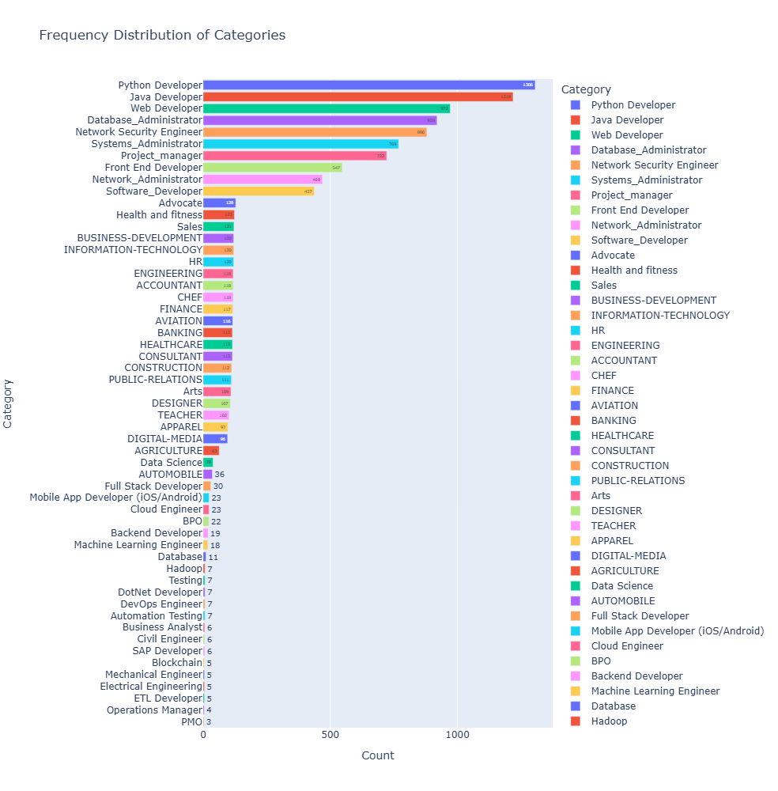
DATA DISTRIBUTION
1. BAR PLOT

Slide 11
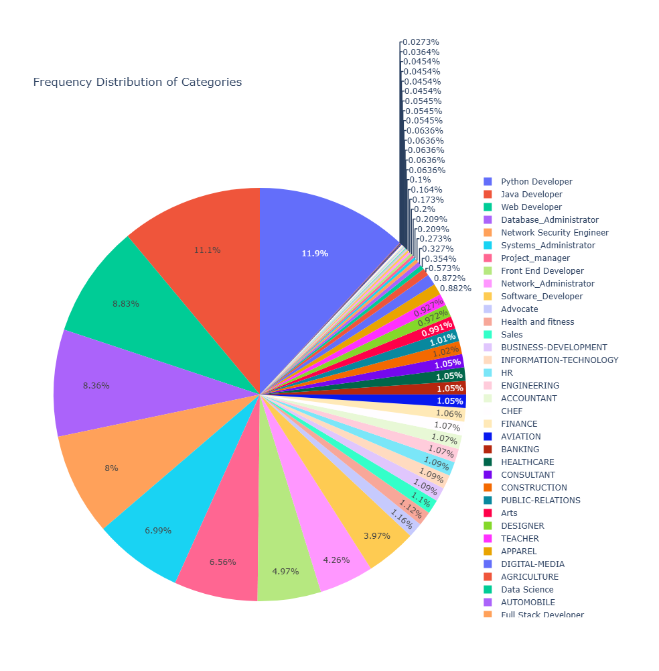
2. PIE CHART

Slide 12
Feature EXTRACTION
Step 1: Resume Cleaning
Unnecessary punctuations, white spaces, ASCII values etc. are removed.
URLs, Social Media elements are removed which don’t contribute any value.
A plain text with free of any unnecessary characters is retrieved.

Slide 13
Contd…
Step 2: Skill extraction
Most common words used in each resume category are obtained.
Each of the words is vectorized using TFID Vectorizer and the categories are encoded using Label Encoder.

Slide 14
PREDICTIVE ANALYSIS
RESUME CATEGORIZATION
Categorize resumes based on common words extracted using Machine Learning models
Built multiple models to analyze and categorize resumes as per input features.
Models Used:
Logistic Regression
Support Vector Machine (Linear, RBF)
Naive Bayes Multinomial
Random Forest Classifier
Decision Tree Classifier
Framework: OneVsRestClassifier for multi-class classification.

Slide 15
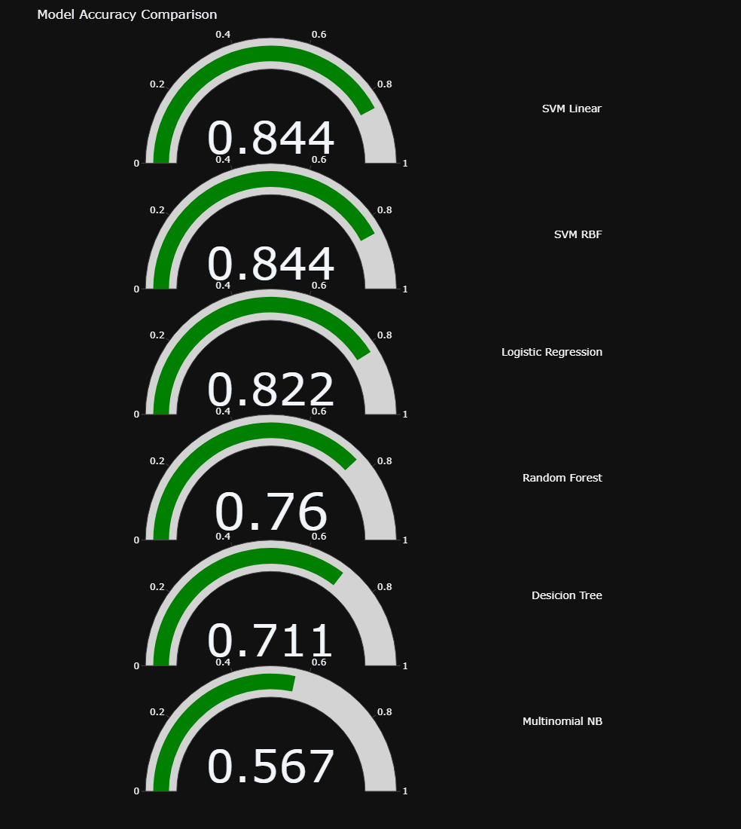
METRICS from models
Among all evaluated models, the SVM model with RBF kernel achieved the highest accuracy.
This model is selected for future predictions of resume categories.
Its superior performance ensures precise categorization for enhanced resume insights.

Slide 16
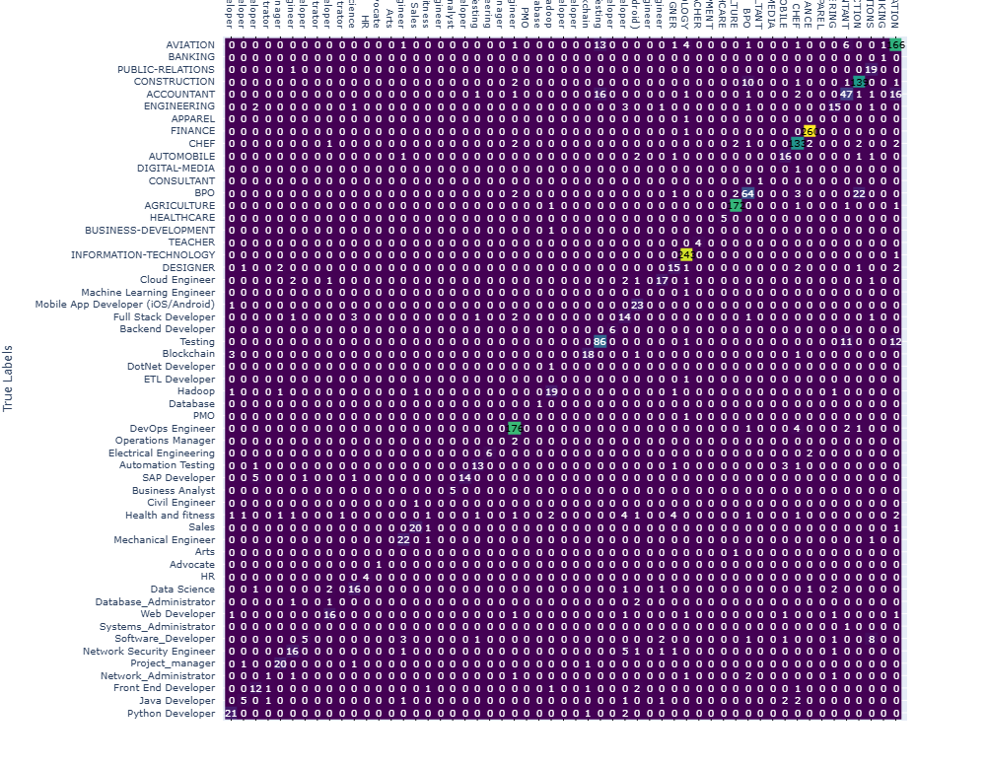
CONFUSION MATRIX
Balanced or Imbalanced Classes: Imbalanced
Trade-Offs: Increasing recall might reduce precision, and vice versa. The confusion matrix helps analyze this trade-off.

Slide 17
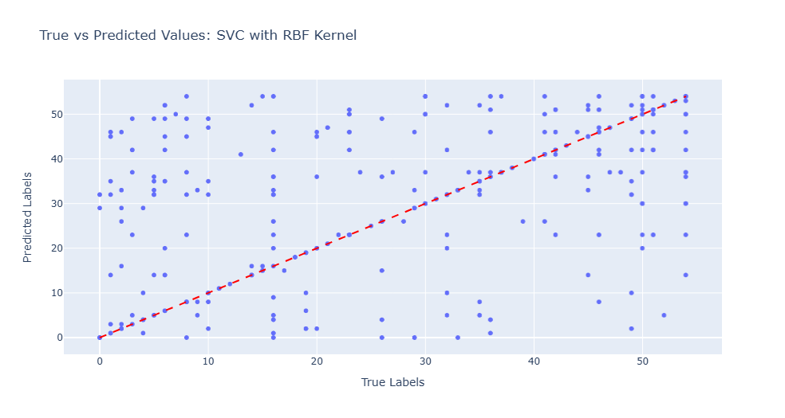
SCATTER PLOT
The scatter plot compares true values (X-axis) and predicted values (Y-axis), with a red dashed line indicating perfect alignment.
Points near the red line show accurate predictions, while outliers suggest areas for improvement.
The clustering of points around the red line suggests the model is well-suited for predicting the categories.

Slide 18

SKILL MATCHING
Predefined skills for each job category are sourced from trusted web resources.
Extracted skills from resumes are matched against these predefined lists.
The retrieved skills are then compared with job descriptions provided by companies.
This comparison identifies gaps or mismatches, allowing individuals to tailor their resumes to better align with the job requirements.

Slide 19
Research Questions ANSWERED
Model Effectiveness: How effectively does the model identify skill gaps between a candidate's resume and industry-standard requirements?
Handing Multiple Resumes: How well does the model handle various resume structures and formats when extracting relevant information?
Skill Upgrade Recommendation: How accurately can the model predict suitable job roles based on the skills and experience presented in the resumes?

Slide 20
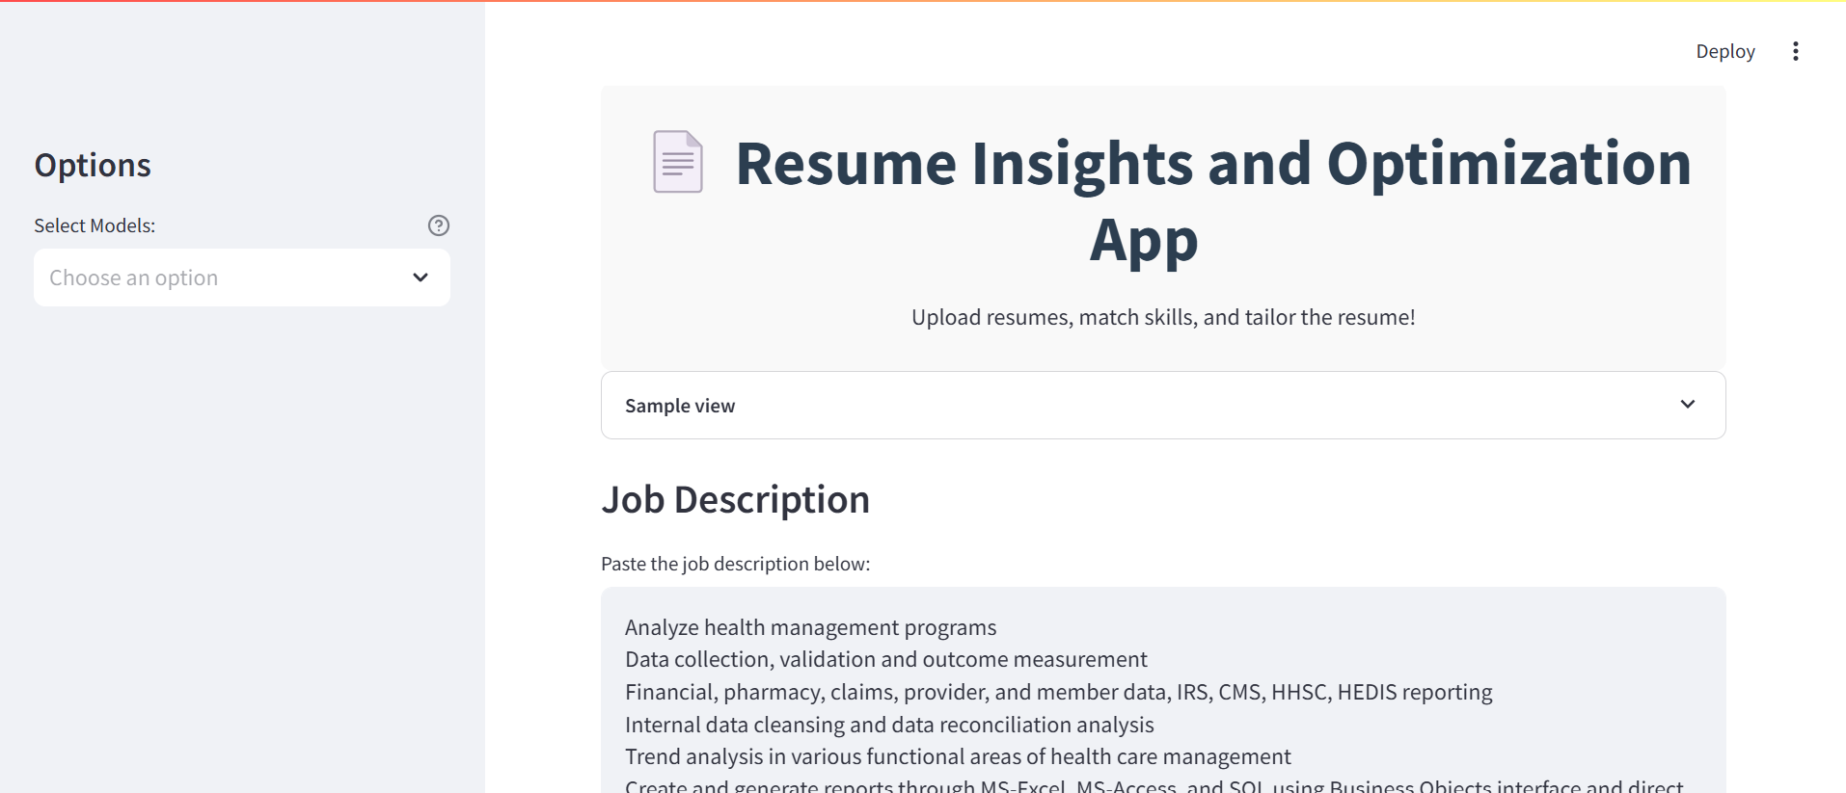
STREAMLIT APP
Built using Streamlit to provide an interactive and user-friendly experience.
Allows users to upload resumes for automated analysis.
Compares resume skills with job descriptions to identify skill gaps.
Provides insights on whether the user is ready to apply or needs to improve skills.

Slide 21
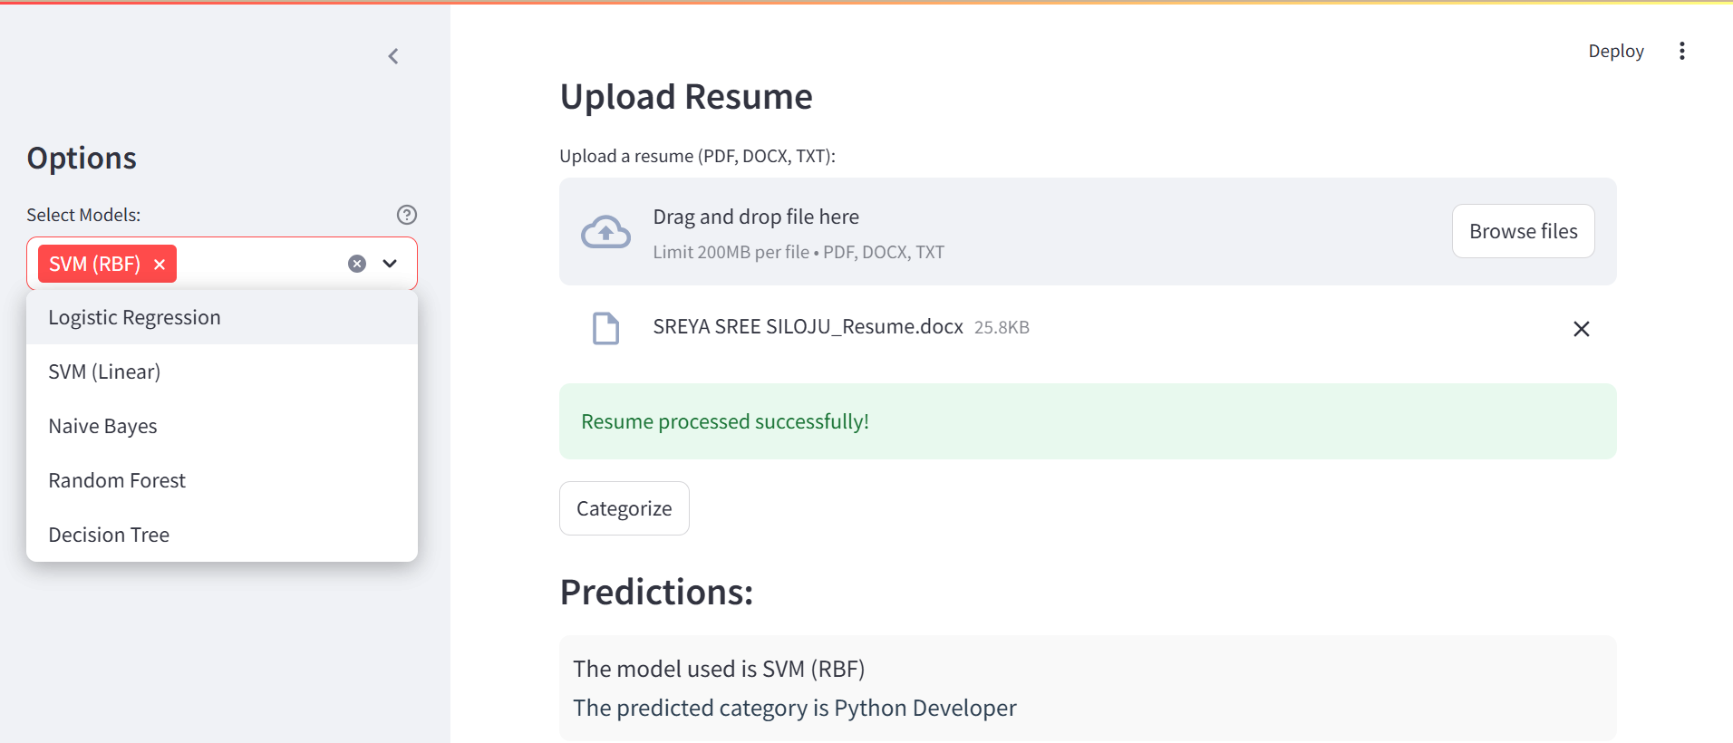
Contd..

Slide 22
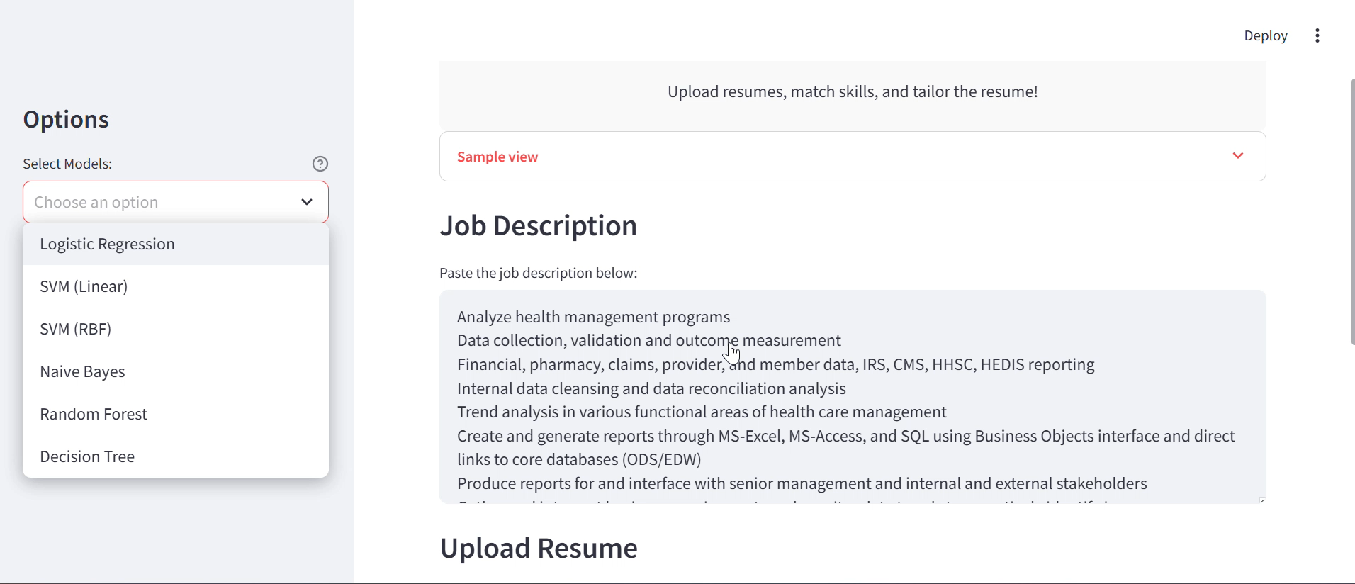
Contd..

Slide 23
THANK YOU
Queries are welcomed!

